Slide 1
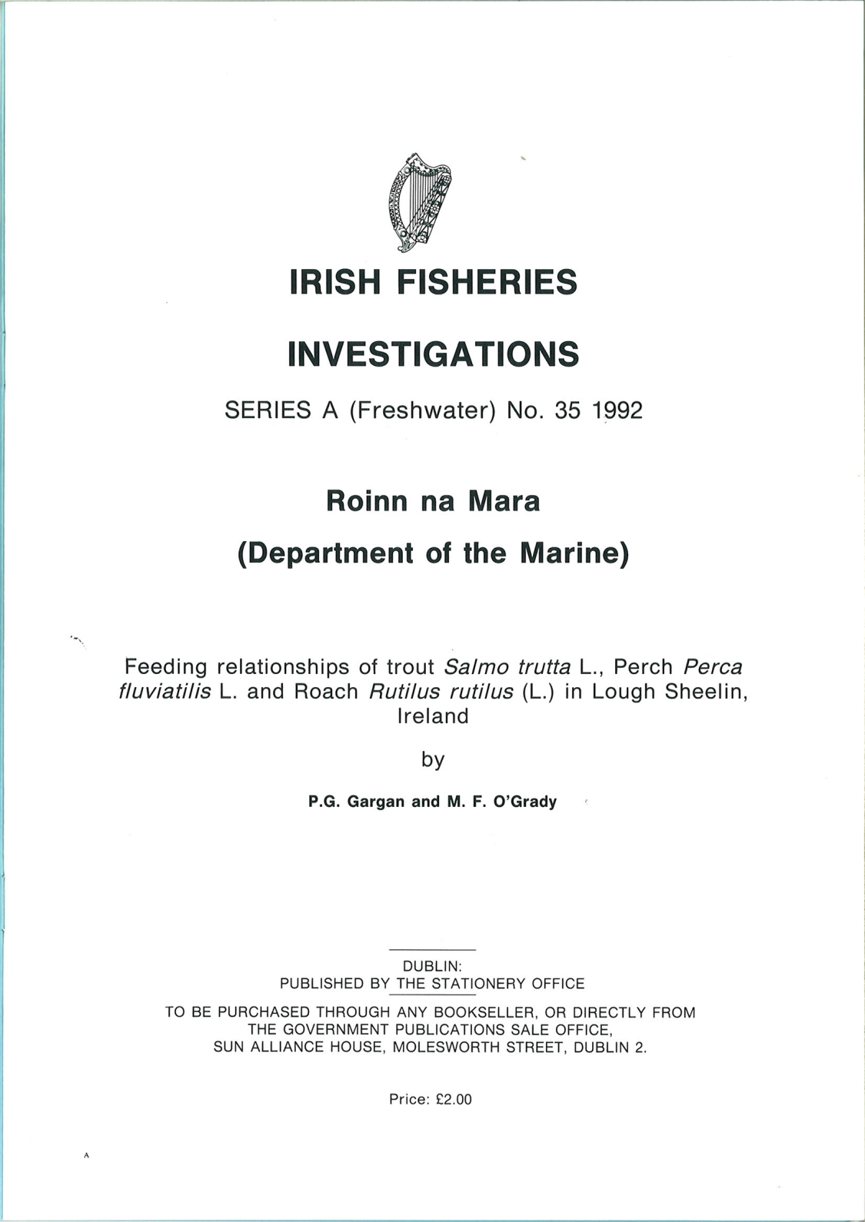

Slide 2
Diet Analysis
% frequency of occurrence (%O), i.e., the number of stomachs in which a food item occurs expressed as a percentage of all stomachs containing food.
This method estimates the proportion of the population that fed on a particular food item.
% composition by number data (%N), i.e., the total number of a particular food item expressed as a percentage of all food items, was determined for vertebrate food items only.
This estimates the relative abundance of the food item in the population diet.

Slide 3
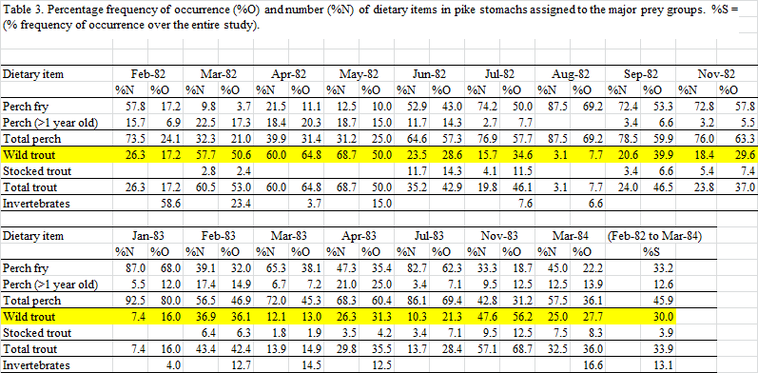

Slide 4
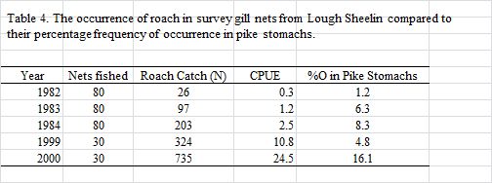

Slide 5
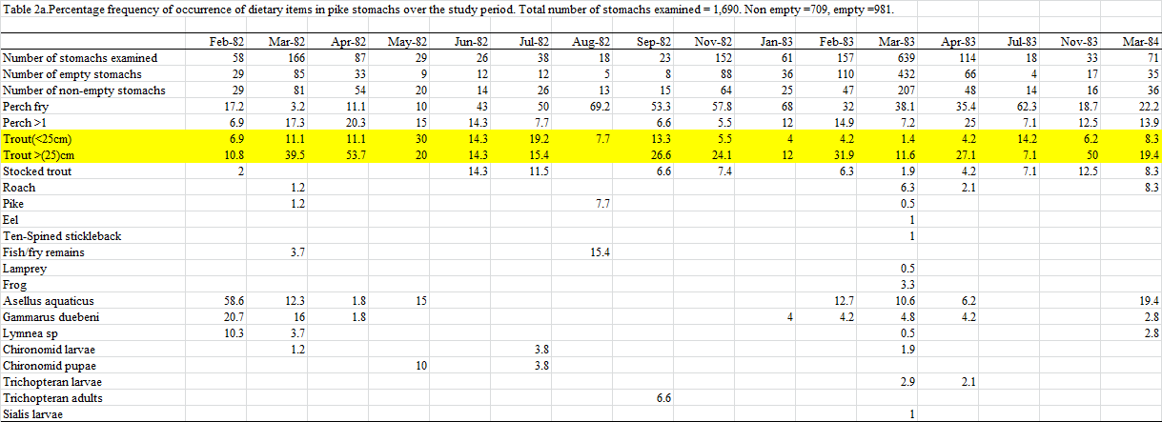

Slide 7
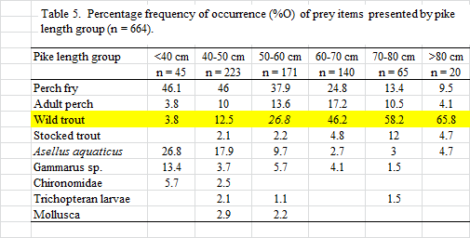

Slide 8
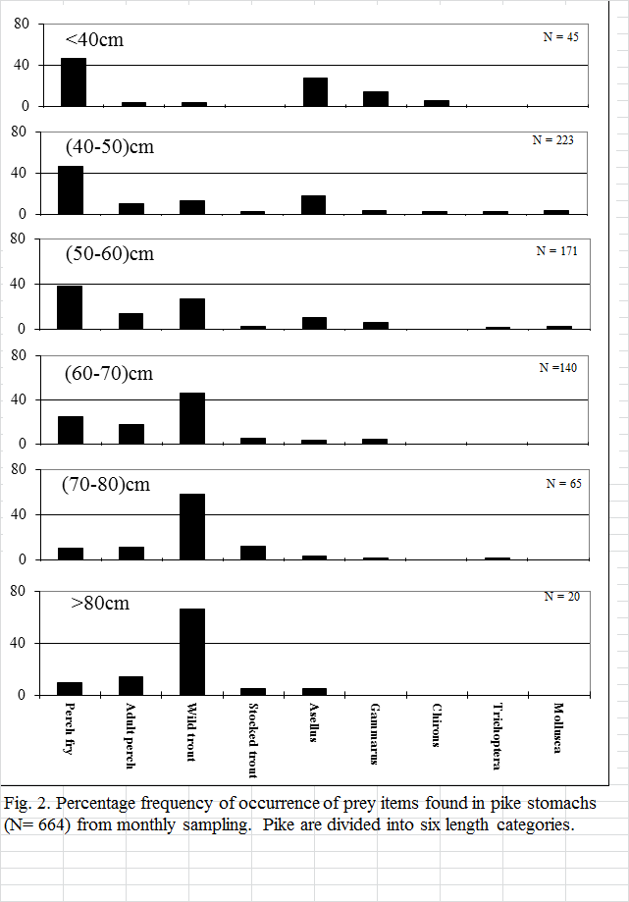

Slide 9
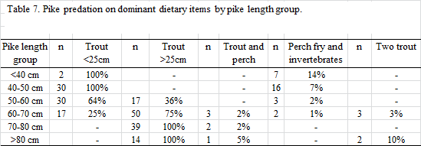

Slide 10
