Slide 1
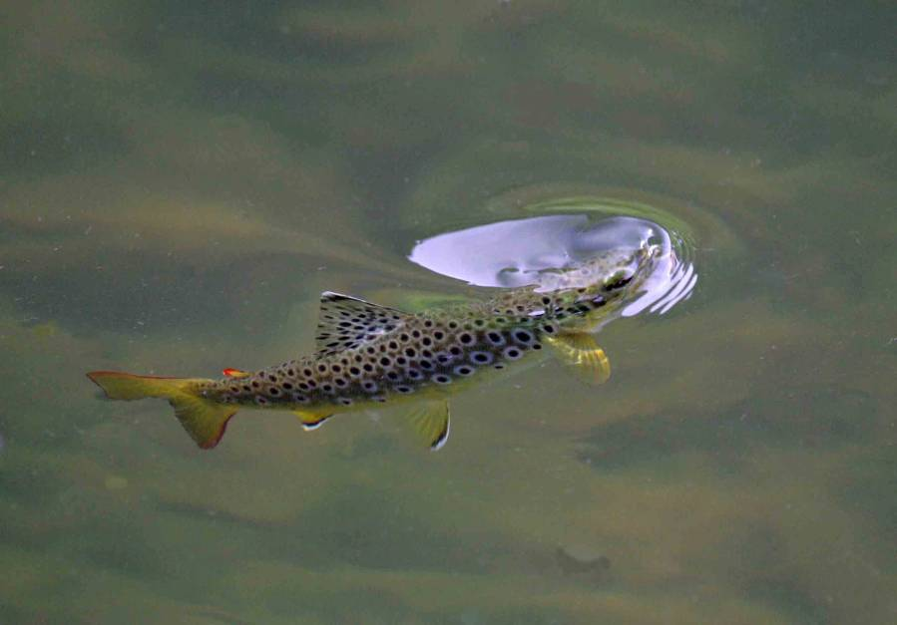
Presentation to IFI group
concerned with
Reviewing Policy on the Current Management of pike in Designated Wild Brown Trout Fisheries.
Professor Martin O’Grady
May 8th, 2017
Page 1 of 27

Slide 2
Questions posed to me by your Chairperson.
.1. The benefit of pike management
2. Do wild brown trout populations increase or decrease in designated wild brown trout fisheries where pike management is carried out?
3. What is international ‘best practice’ in the management of both spp.?
4. Is pike a native sp.?
5. Is the theory that pike prefer to prey upon brown trout rather than other spp. valid?
6. What effect does pike predation have on other coarse fish spp. in the designated
fisheries?
7. What impact do other spp. have on brown trout in the lakes?
8. What Irish river systems and lakes now contain pike but did not contain pike when
record keeping began?
9. Can pike be effectively removed from systems into which they have been
introduced?
10. Which Irish waters (if any) are more suited to pike than brown trout now- and why?
11. What scientific evidence is available to demonstrate what would happen to other
spp. populations if IFI stopped managing pike in the designated waters?
12. Which waters, if any, should be considered as unique ‘brown trout fisheries’, and
why?
13. What, if any, is the optimum level of natural predation to sustain healthy species.
Page 2 of 27

Slide 3
. What is international ‘best practice’ in the management of both spp.?
. Which waters, if any, should be considered as unique ‘brown trout fisheries’, and
why?
Page 3 of 27

Slide 4
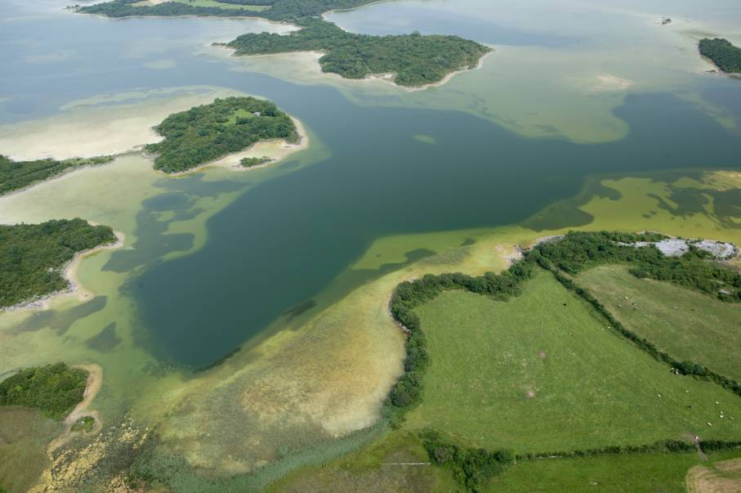
There is no “International Best Practise” in relation to designated Irish Wild Brown Trout
Fisheries. Why ?? – these lakes are unique. There are no such lakes anywhere else in the world!
I.F.I. are the policy makers for these lakes.
Their uniqueness is due to a
combination of factors;-
Shallow and wind swept.
Temperate climate.
Geology.
High water clarity.
Very large insect populations
which hatch over a prolonged
period.
Availability of extensive
trout spawning and nursery
streams discharging to
individual lakes.
Irish lakes in this category
include;- Loughs’ Arrow, Leane, Inchiquin,
Loughrea, Corrib, Mask, Carra,
Cullin, Conn, Melvin, Sheelin, Ennell
and Derravaragh.
Page 4 of 27

Slide 5
Is the pike a native species.?
In my view this question has not yet been answered.
Until additional genetic markers become available or new genetic procedures
are developed this question cannot be addressed comprehensively.
I would suggest that, as a group, you consider discussing this issue with
Irelands leading geneticists.
Page 5 of 27

Slide 6
Do wild brown trout populations increase or decrease in designated wild brown trout
fisheries with pike removal ?
BIOLOGY , ECOLOGY, and M ANAGEMENT OF PIKE IN IRISH WATERS WITH PARTICULAR REFERENCE
TO WILD BROWN TROUT LAKE FISHERIES
A POSITION PAPER – JANUARY, 2008
O’Grady and Delanty.
A Comparison of Trout C.P.U.E Values in lakes with and without Pike Control
Lake Year Trout CPUE Pike Control
Carra 1993 4.4 Yes
Carra 2001 4.3 Yes
Carra 2009 6.6 Yes
Ennell 2007 3.43 No
Corrib 1996 2.1 Yes
Corrib 2012 1.9 Yes
Sheelin 2014 3.5 Yes
Ree 2014 1.1 No
Coarse fish last 10
Lakes years. 0 to ≤ 0.1 No
Page 6 of 27

Slide 7
C.P.U.E. values for Trout in Lakes with and without Pike stocks.
Lake C.P.U.E. Value Pike (Present/Absent)
Melvin 15.23 Absent
Leane 11.5 Absent
Conn 2.03 Present (some control)
Numerous
small lakes
in upper Shannon
/ Erne systems. 0 to ≤ 0.1 Present (no control)
Page 7 of 27

Slide 8
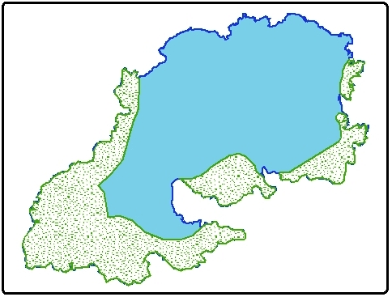
Exceptions to the Rule
Research has shown that there are a number of these designated wild brown trout
fisheries where pike control, in the interest of enhancing trout stocks, is unnecessary.
Why ?
In a few lakes pike production is “capped severely “ by a paucity of weed beds limiting both spawning and
nursery areas. This is the case in Loughs’ Inchiquin, Loughrea, Ennell and Derravaragh.
Lough Sheelin, unlike the
aforementioned lakes has a very
extensive weed bed area. This
is the prime pike spawning and
nursery area. Essentially the stock
density of pike here is controlled by
the availability of fodder fish.
Page 8 of 27

Slide 9
In which designated wild trout fisheries is pike control critical ?
Pike management is critical in the following waters ;-
Arrow, Corrib, Mask, Carra, Cullin, Conn and Sheelin.
Research has shown that pike control is not critical on;-
Loughrea, Derravaragh, Ennell and Inchiquin.
The question of pike control does not yet arise in
relation to Loughs’ Leane and Melvin.
Page 9 of 27

Slide 10
Is the theory that pike prefer to prey upon brown trout rather than other spp. valid?
This is not a theory. It is a proven scientific fact.
In a year when the survey nets caught
35 Roach to 1 trout
there were
2.25 Roach to 1 trout
in pike stomachs.
From O'Grady and Delanty, 2008.
Other studies by Healy in L. Glore, Toner in L. Corrib and Gargan in l.Sheelin
have all observed the same trend.
Page 10 of 27

Slide 11
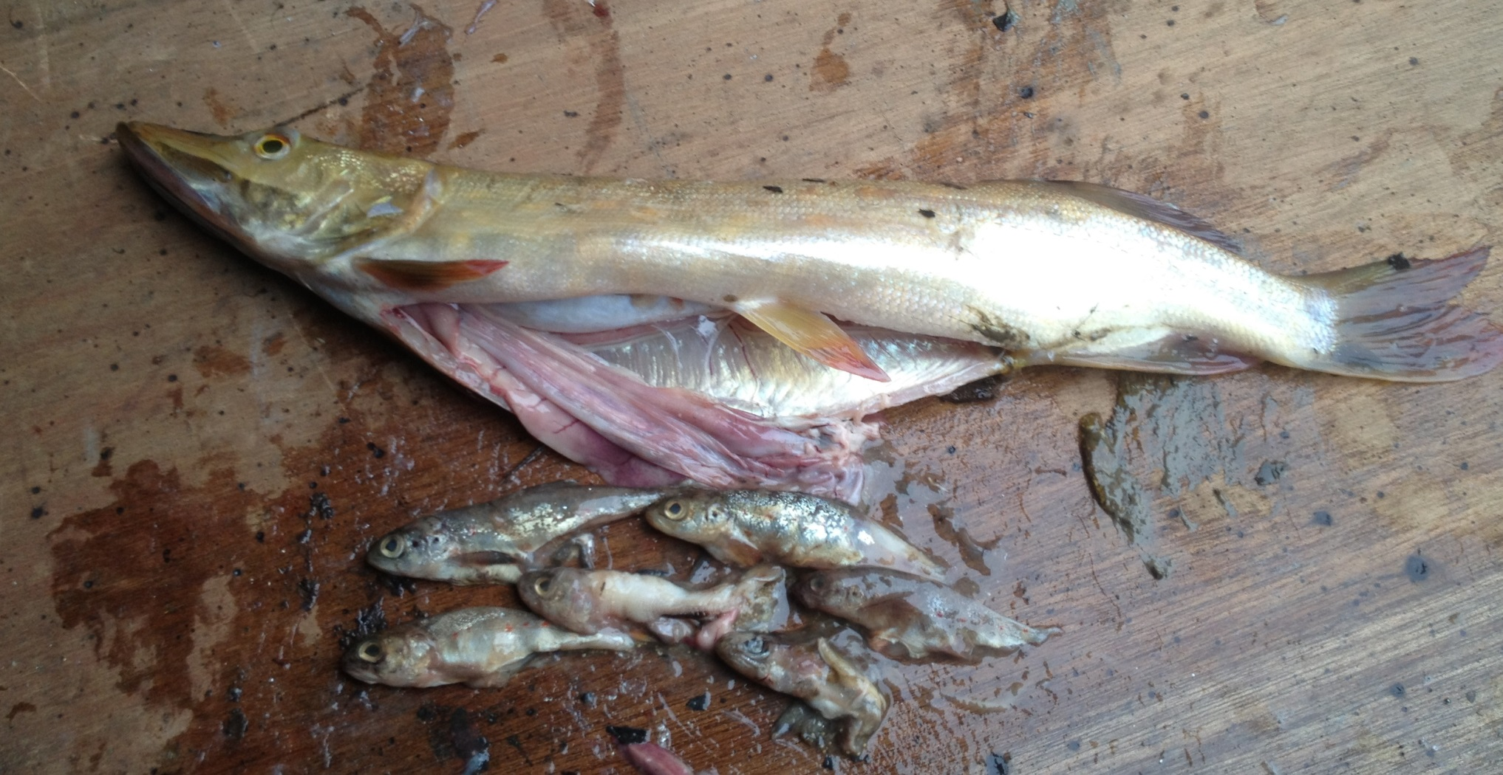
Pike will also target salmon smolts as they migrate to sea in Loughs’ Conn, Cullin and Corrib.
Page 11 of 27

Slide 12
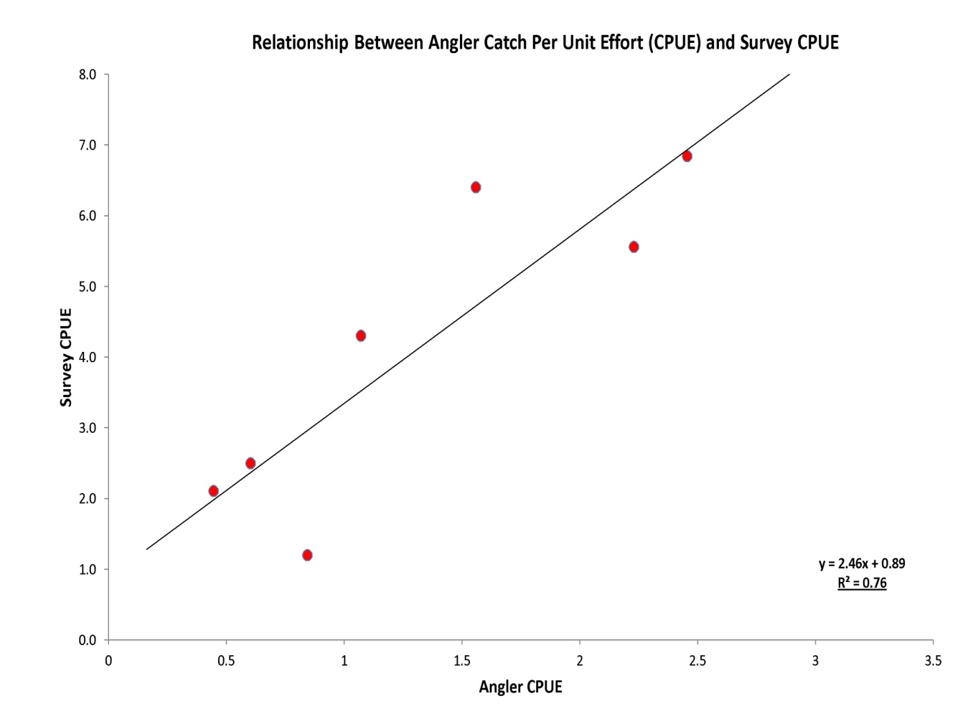
Benefit of pike removal in designated trout lakes.
The benefit of managing pike stocks in selected designated trout lakes will be to increase
standing crops of trout thereby improving the quality of trout angling. The data, presented
below for L. Conn, clearly illustrate a linkage between these two factors (angling catches and
trout stock densities).In designated trout lakes there is a danger that pike predation could depress
trout numbers to a point where quality angling would no longer be available. This would lead to a significant
loss of income to these areas.
Page 12 of 27

Slide 13
. What effect does pike predation have on other
coarse fish spp. in the designated fisheries?
No detailed research in this area.
The fact that there is quality coarse angling for cyprinids and other species
in excellent pike angling waters is an indication that pike do not significantly
depress coarse fish numbers.
Page 13 of 27

Slide 14
What impact do other spp. have on brown trout in the lakes?
Surveys indicate that selected lakes can support substantial brown trout populations,
even when large populations of cyprinids and perch are present, provided pike stocks
are managed and/or limited by the extent of weed beds and water clarity remains high.
Page 14 of 27

Slide 15
. What Irish river systems and lakes now contain pike but
did not contain pike when record keeping began?
I.F.I. staff are aware of three waters where pike have been recently introduced;-
Lakes in the upper Oughterard River system (Corrib Catchment).
Ballintra System in south Donegal.
Cavetown Lake near Boyle (Shannon catchment)
Surveys by I.F.I. staff in these three sub catchments suggest that trout stocks are
at, or close to, extinction in all three areas. Prior to pike introductions to these waters
there had been large trout populations in all of these waters.
Page 15 of 27

Slide 16
Can pike be effectively removed from systems into which they have been introduced?
Yes they can be controlled but not eliminated.
Page 16 of 27

Slide 17
Pike Stock Management Status
Significant since the early 1960s’
50.0cm
Pike management continued from the early 1960s’
up to 1980 and then ceased.
By 1986 a significant adult pike population was evident.
A balanced undisturbed pike population was evident
by 1996.
A long term data set on the structure of the pike stock in Lough Corrib at intervals from 1968 to 1996.
Page 17 of 27

Slide 18
Which Irish waters (if any) are more suited to pike than brown trout now- and why?
This is not the case. Trout and perch populations have increased in many lakes in the last
decade. During the same period roach populations have “crashed” and there has been
a decline in pike numbers. This is the case in the Shannon and Erne systems in particular.
Three significant events, since the 1970s’, have resulted in major changes in our fish stocks;-
Excess phosphorous discharges to many of our lakes, since the mid-1970s’, allowed major
and persistent algal blooms to appear in many lakes.
Roach, an invasive species, were introduced to and spread through many catchments in
the1970s’ and early 1980s’.
Another invasive species. The zebra mussel were introduced to the lower Shannon in the
early 1980s’ and have since colonised many lakes in Ireland.
These three events have had far reaching consequences for our fishes’.
Page 18 of 27

Slide 19
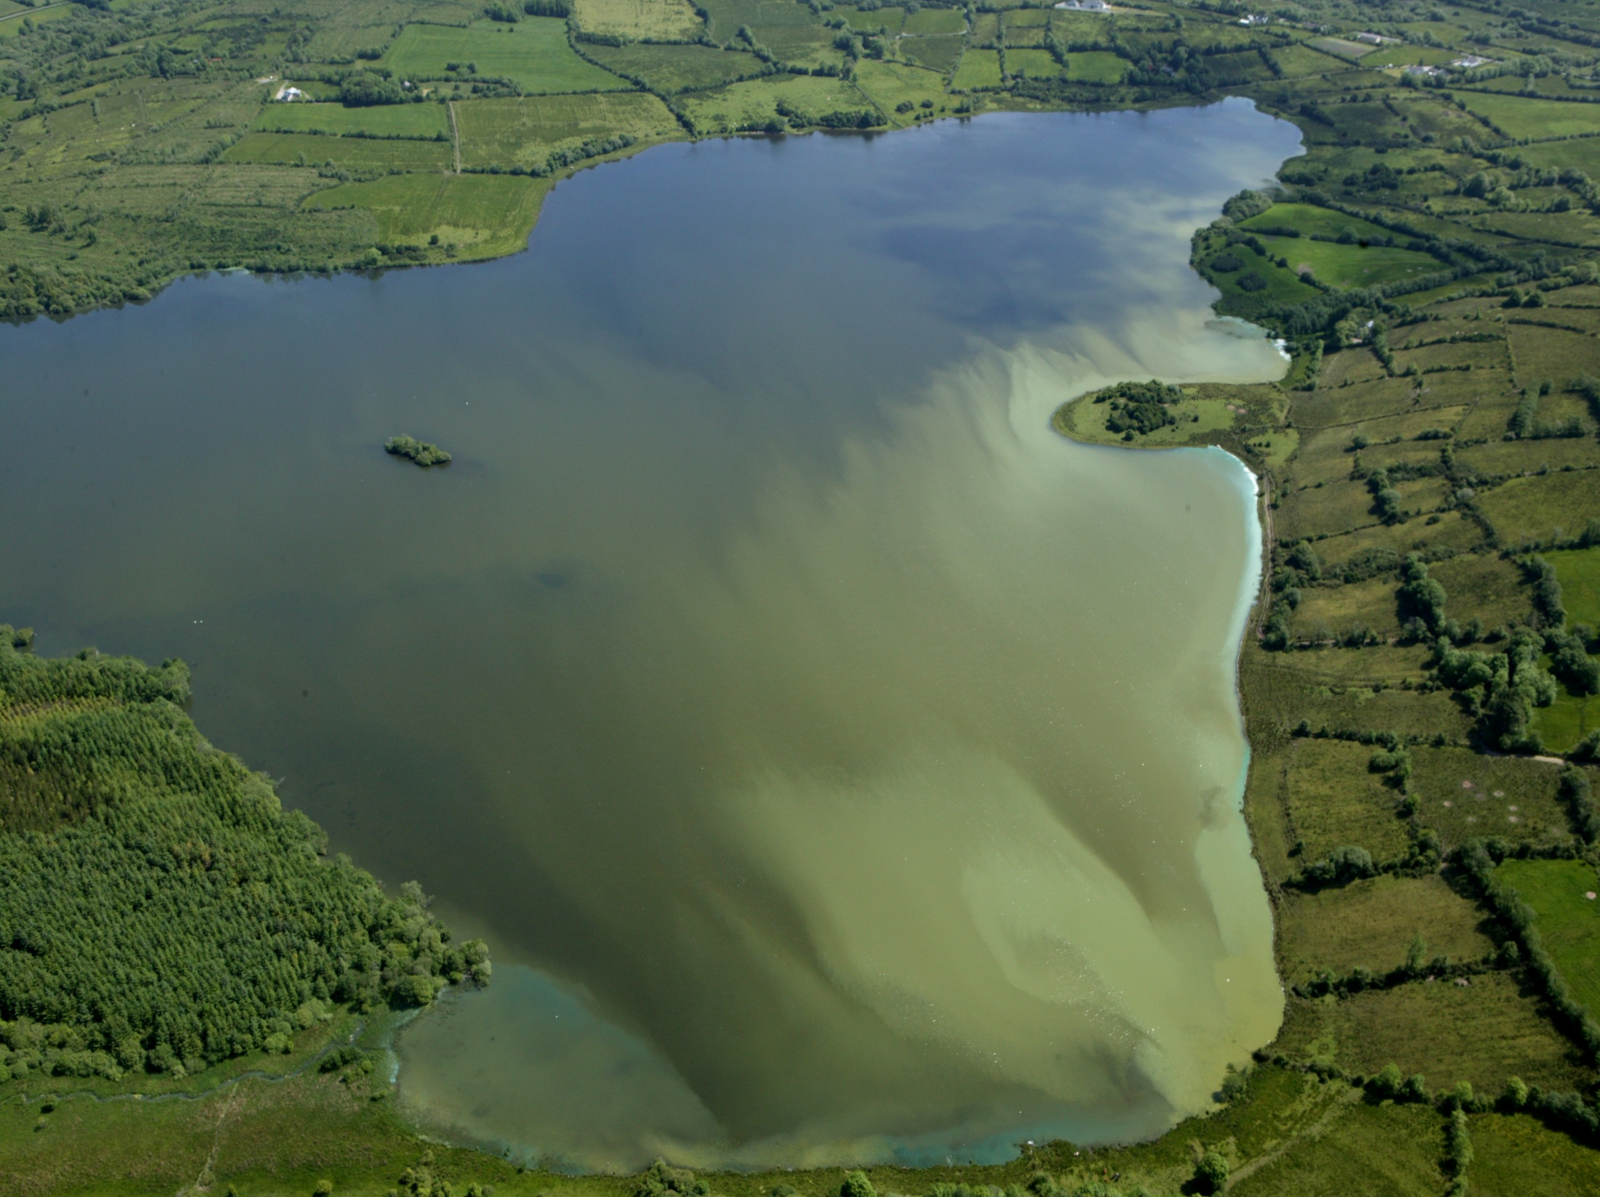
Persistent algal blooms prevent sunlight from reaching the bed of lakes and as result
aquatic weed production collapses.
Page 19 of 27

Slide 20
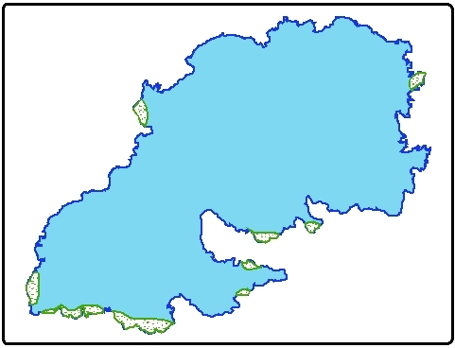
1972
The extent of weed bed areas
in L. Sheelin in 1972 and 1990.
1990
Page 20 of 27

Slide 21
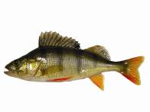


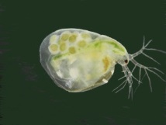
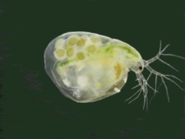
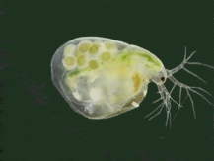



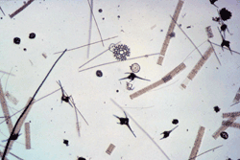



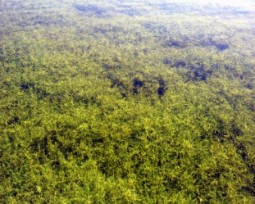
Early 1970s’ to early 1980’s
Pelagic
Demersal
Page 21 of 27

Slide 22

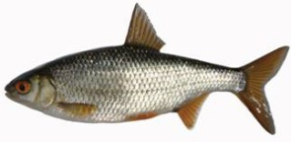





Page 22 of 27
Late 1980s’ to end of the 00s’
Available fodder for pike increased
20 to 30 fold compared to the 1970s’

Slide 23
2006 to 2015
The huge increase in pike fodder present in the 1980s’and 1990s’ is gone
and is now present in the form of Zebra mussel flesh.
Pelagic
Demersal
Page 23 of 27

Slide 24
The Available 36 year Data Base
Page 24 of 27

Slide 25
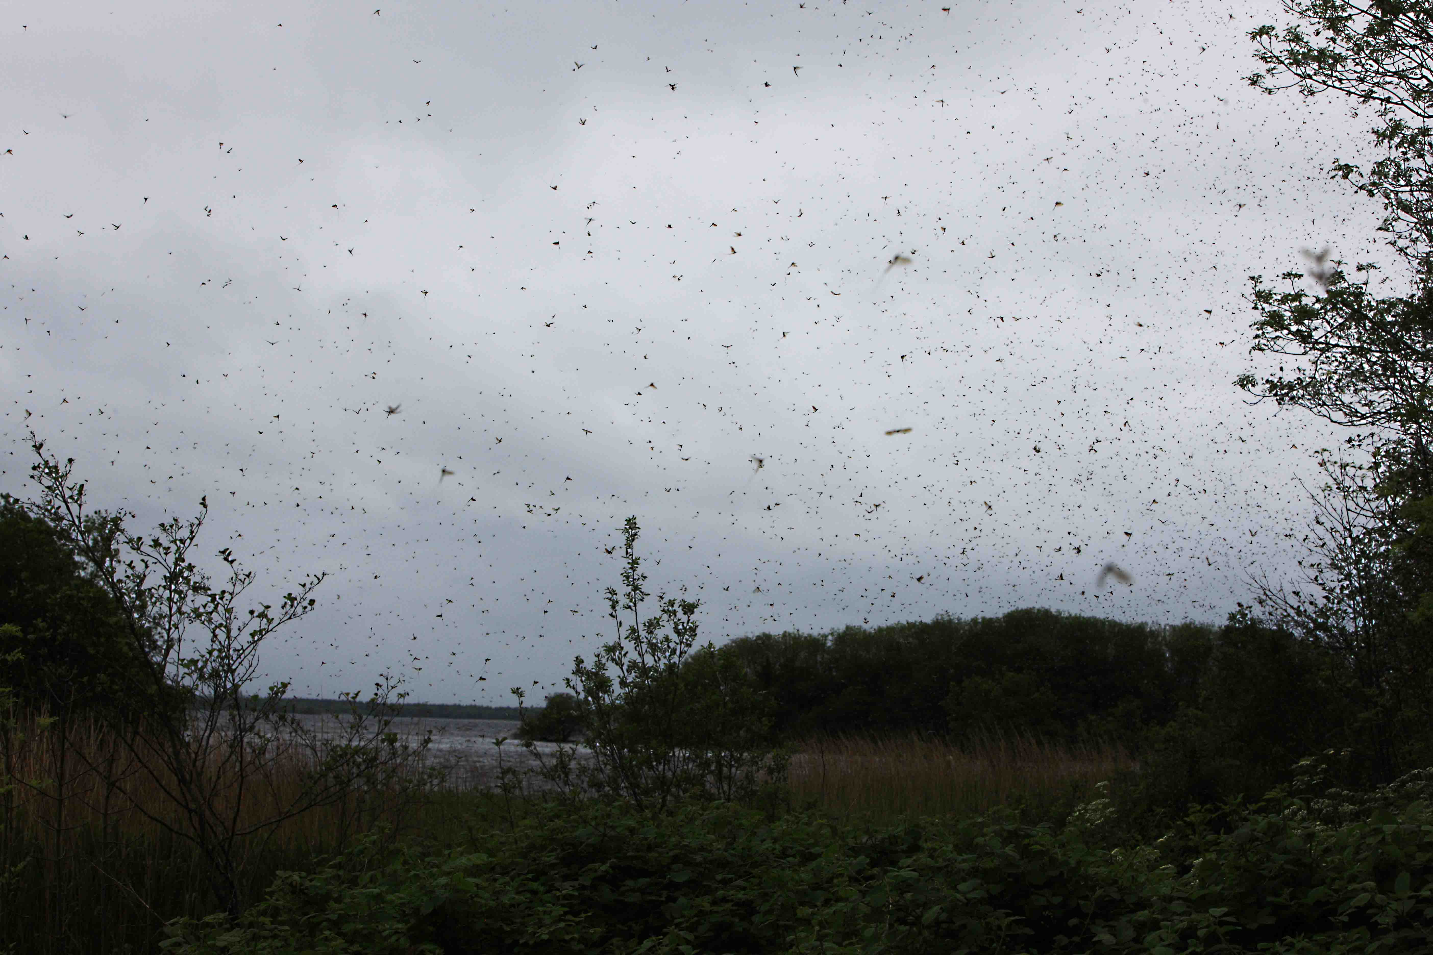
The Resurgence in Mayfly Stocks is astonishing
in many lakes which have been colonised by Zebra mussels.
Similar events have been recorded in U.S. lakes following zebra mussel infestations.
Page 25 of 27

Slide 26
What, if any, is the optimum level of natural predation to sustain healthy species
The inference in this question would appear to be that pike predation on trout is
necessary to maintain a healthy trout stock . This is not the case.
If it were surveys should have illustrated the presence of poorly conditioned trout in
waters with no pike present (Loughs’ Leane and Melvin) and/or in waters with limited
pike and very large trout populations (Loughs’ Inchiquin and Carra). This is not the case.
Page 26 of 27

Slide 27
Summary and Conclusions
The waters which should be considered unique brown trout fisheries are listed and the
parameters which place them in this category are outlined.
The science behind the necessity to manage pike in some of these lakes (7) is provided.
In the authors view this management programme should continue until the question
of the pike being a native species, or not, is established beyond doubt.
A heavier reliance on electro-fishing to manage pike stocks is recommended. There is no
scientific reason why pike anglers should not angle on these waters – pike management
will reduce, not eliminate the pike population.
A failure to continue the pike management programme ,where required, will result in a
significant socio-economic loss in certain areas.
There are more than enough coarse fisheries in Ireland to accommodate pike anglers
apart from the 7 waters where pike management is recommended
Regrettably the decline in pike stocks in coarse fisheries cannot be addressed because
zebra mussel populations cannot be eliminated. Perhaps consideration should be given
to introducing a closed season for pike in these waters during the spawning season
to afford the bigger older fish more protection ? This situation may be further exacerbated
in waters where Asian Clam populations become established.
Page 27 of 27

